Slide 1
ACP Leadership Day – Deep Dive into the Issues
May 14, 2024
Shari M. Erickson, MPH
Chief Advocacy Officer and
Senior Vice President, Governmental Affairs and Public Policy

Slide 2

Red + Blue = Purple
@ACPIMPhysicians
Notes:
I’ve been thinking a lot about what it means to be a leader – not only as a leader myself, but for my staff to be leaders in their areas of expertise, and for our members to be leaders – particularly leaders when it comes to advocacy and yes, even leaders the dirty world of politics. I am a sucker for books on management and leadership and recently came across a book called the Purple People Leader, which is honestly nothing groundbreaking, but it spoke to me in several ways. One – my all time favorite color is purple and it is the color most associated with my favorite musical artist (more on that later), but also because there seems to be so very little of it these days when it comes to governmental leadership. The concept in my own view/words is that to truly lead a team, you don’t abandon either the red or the blue views (and in this country we associate red with conservative and blue with liberal – although many other countries view it the other way around), but you dig down to the core goals that you are trying to achieve and then lead from there. Build the relationships, get to know others, build trust, have compassion and understanding and then put in the work to see where you can find solutions that might just make everyone a little bit happy or even a little bit (but not a lot) unhappy and work from there. Work to recognize your biases in any interaction and try to put them at bay. We need more of this in our country and so I challenge myself and all of you, as leaders of the College, to be more purple in your leadership so that we can truly be a team, even when we disagree.

Slide 3

Purple in Politics…
Purple is also unofficially used in the United States to denote a "swing state", swing district, or county. (i.e. one contested frequently between the Republican Party, whose unofficial color is red; and the Democratic Party, whose unofficial color is blue).
Purple is also used by centrists to represent a combination of beliefs belonging to the Republicans and the Democrats.
It has also been used to reference Purple America, noting that electoral differences nationwide are observed more on discrepancies instead of unity.
Purple has been the colour of the international Pirate Party movement since the founding of the Swedish Pirate Party in 2006. (focused on the right to privacy)
In Australia, purple is used by the Australian Electoral Commission, the independent statutory authority responsible for the management of federal elections.
In Canada, the People's Party of Canada is a right-libertarian and right-wing populist party whose color has been purple since its founding.
In Europe, purple tends to be used for movements, parties and governments that are neither clearly right nor left.

Slide 4




Slide 5
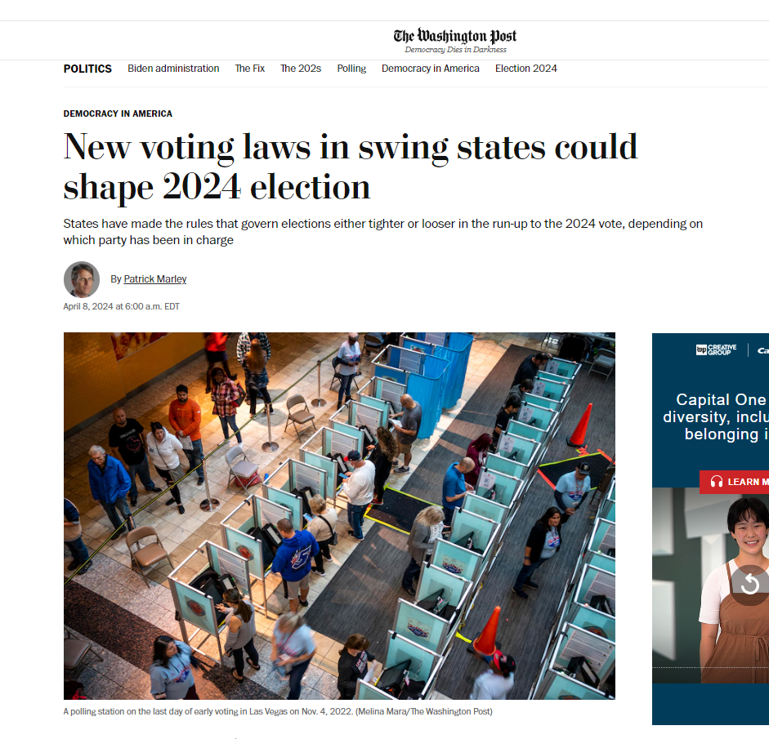
This will be difficult, as 2024 is an Election Year
ID requirements
Absentee ballot deadlines and limits on mail-in ballots vs. mail ballots with pre-paid postage
Potentially fewer early-voting sites and fewer drop-box locations
Gerrymandering
Changes in the make-up of election boards
Limits to handing out water or food to those waiting in line to vote

Slide 6
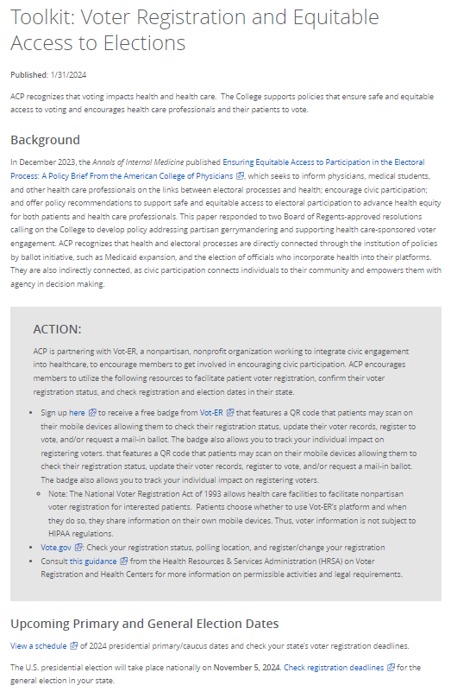
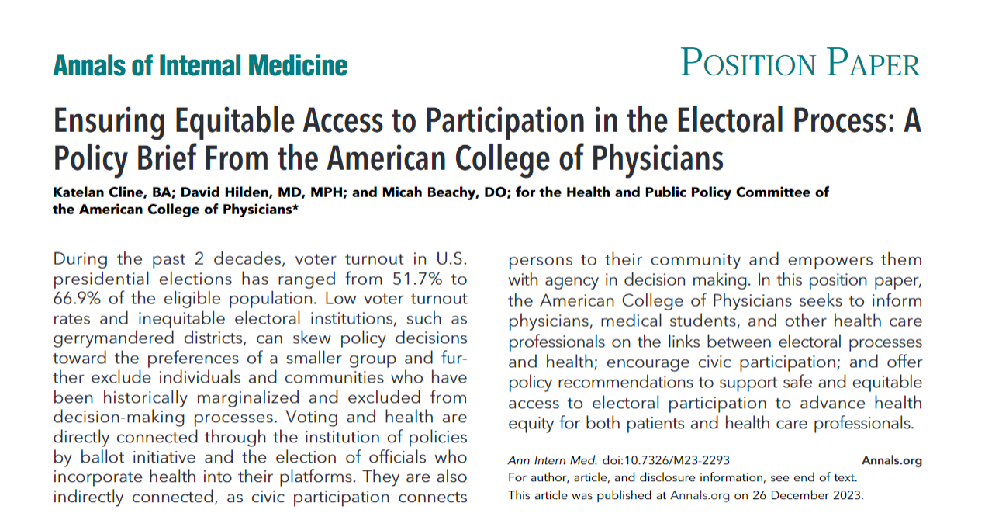
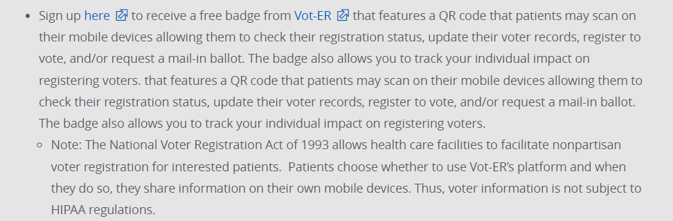

Equitable Access to Electoral Process

Slide 7
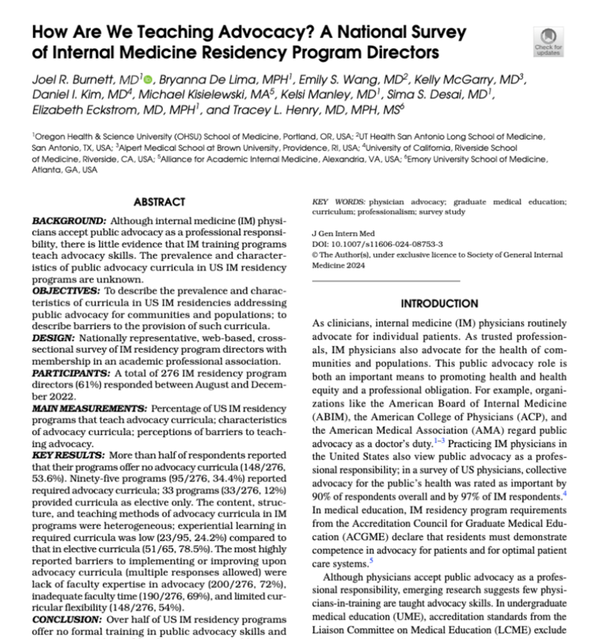
The importance of physicians engaging in advocacy
Organizations like…the American College of Physicians (ACP), and the American Medical Association (AMA) regard public advocacy as a doctor’s duty.
In a survey of US physicians, collective advocacy for the public’s health was rated as important by 90% of respondents overall and by 97% of IM respondents
To the authors’ knowledge, no studies describe the prevalence and characteristics of curricula in IM residencies addressing public advocacy for communities and populations.
More than half of PDs (53.6%) reported no advocacy curricula, and many reported lack of faculty expertise in advocacy as a barrier.
https://x.com/JBurnettMD/status/1788430773013582288

Slide 8
2024 Policy and Advocacy Priorities
Promoting patient access to care
Protecting the patient-physician relationship
Addressing prescription drug access and affordability
Reducing administrative burden/“Patients before Paperwork”
Compensating physicians, particularly for the value of care they provide
Supporting programs that strengthen the physician workforce
Health information technology
Preventing Firearms-related Deaths and Injuries

Slide 9
How do we decide on what priorities to consider?
Needs of the Internal Medicine profession/ ACP members
Environmental Feasibility/ Opportunities for Action – Can we get some wins?
ACP Strategic Priorities:
Valued Professional Identity;
Diversity Equity Inclusion;
Innovation
Membership Growth and Engagement;

Slide 10
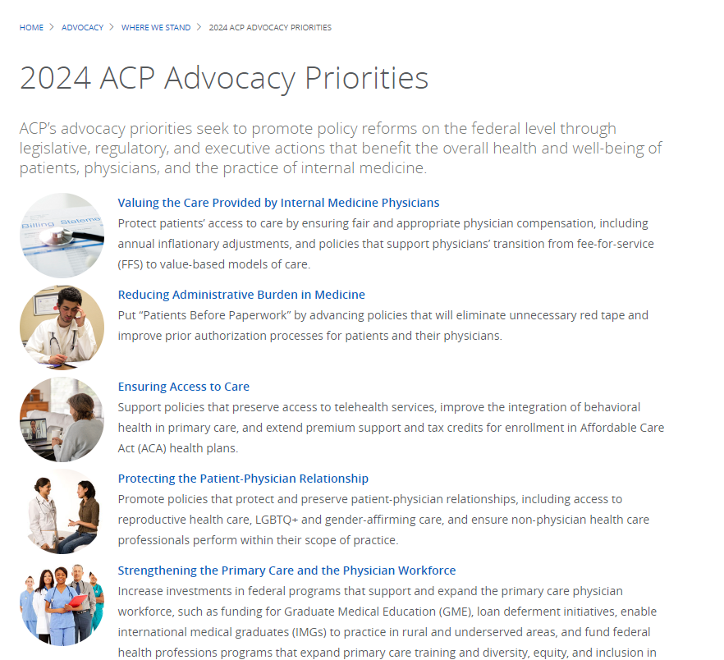


Slide 11
Leadership Day Focus – Three Key Issue Areas
Reducing administrative burden/“Patients before Paperwork”
Compensating physicians, particularly for the value of care they provide
Supporting programs that strengthen the physician workforce

Slide 12
Converting what we stand for into specific legislative “asks”
An ask is a specific action we request from a lawmaker:
  bills we want them to introduce, co-sponsor, and vote for,
  bills we want them to try to revise (amend),
  bills we want them to oppose and vote against, if not revised as we seek;
  legislative oversight over federal agencies and the executive branch.

Slide 13
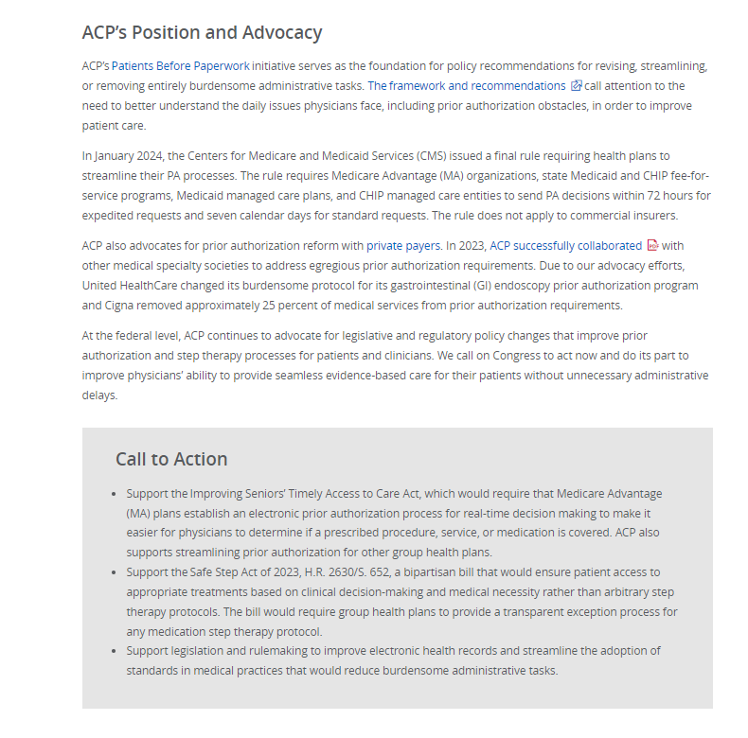


Reducing Administrative Burden in Medicine – Patients Before Paperwork
Prior Authorization/ Medicare Advantage utilization management
Step therapy
Inbox management
Improving EHRs/Quality reporting issues
Leadership Day 2024 Ask:
Support H.R. 2630/S. 652 – The Safe Step Act

Slide 14
Administrative Burden – Step Therapy Call to Action
Support The Safe Step Act (H.R.2630/S. 652)
The patient already tried and failed on the required drug.
The delayed treatment will cause irreversible consequences and negatively affect the patient’s medication.
The prescription drug to which the health plan is requiring the patient to “fail first” on will cause harm to the patient.
The required drug will prevent a patient from working or fulfilling activities of daily living.
The patient is stable on their current medication.
Provides five exceptions to fail first protocols and requires that a group health plan grant an exemption if an application clearly demonstrates any of the following:

Slide 15

Administrative Burden – Step Therapy
ACP policy:
All step therapy and medication switching policies should aim to minimize care disruption, harm, side effects, and risks to the patient.
All step therapy and nonmedical drug switching policies should be designed with patients at the center, taking into account unique needs and preferences.
All step therapy and nonmedical drug switching protocols should be designed with input from physicians and pharmacists; feature transparent, minimally burdensome processes that consider the expertise of a patient’s physician; and include a timely appeals process.

Slide 16
Cosponsors of the Safe Step Act
House of Representatives (H.R. 2630)
Senate (S. 652)
124 Democrats
70 Republicans
Across 43 states and territories
Original cosponsors:
  Rep. Ruiz (D-CA-25)
  Rep. Miller-Meeks (R-IA-1)
  Rep. McBath (D-GA-7)
  Rep. Chavez-DeRemer (R-OR-5)
  Rep. Blumenauer (D-OR-3)
26 Democrats
13 Republicans
2 Independents
Across 28 states
Original cosponsors:
  Sponsor who originally introduced the bill: Sen. Murkowski (R-AK)
  18 Senators – 9 Democrats, 8 Republicans, 1 Independent

Slide 17
Given its popularity, why hasn’t the Safe Step Act passed?
In May 2023, the Safe Step Act was passed through the Senate Health, Education, Labor, and Pensions (HELP) Committee as an amendment to the Pharmacy Benefit Manager Reform Act.
The House version of the legislation also has significant bipartisan support.
Despite its widespread popularity, both versions of the bills have not yet been taken to the floor for a vote.
As we move toward Election Day, health care reform legislation such as the Safe Step Act may be more likely to pass during the lame duck session of Congress – which is why we need to keep it on Congress’ radar now!
Note that there is no CBO cost estimate available for this bill at this time.

Slide 18
Step Therapy – What to say if:
The lawmaker states – I thought that ACP was supportive of reducing prescription drug prices, doesn’t step therapy help address that problem?
You answer: While some studies have found step therapy can successfully drive cost savings without negatively impacting patient care. Many others have shown that overall health spending increased due to an uptick in hospitalizations and other services resulting from new symptoms or complications.
These step therapy policies can also serve to:
Restrict patient access to effective treatments,
Put patient health and safety in jeopardy by subjecting patients to potential adverse effects,
Interfere with the patient—physician relationship, and
Absorb practice resources with burdensome approvals and documentation requirements.
Share an example from your own practice and/or your patient experiences to reflect the impact of step therapy on the health and safety of your patients

Slide 19
Step Therapy – What to say if:
You lawmaker expresses interest in or support for this issue but is uncertain about what bills we are supporting or what to do about it.
You answer: Provide them with the “leave behind” folder, which explains the issue and the bill(s) we are asking them to support.
Give examples from your own practice and/or your patient experiences to reflect the impact of step therapy on the health and safety of your patients.

Slide 20

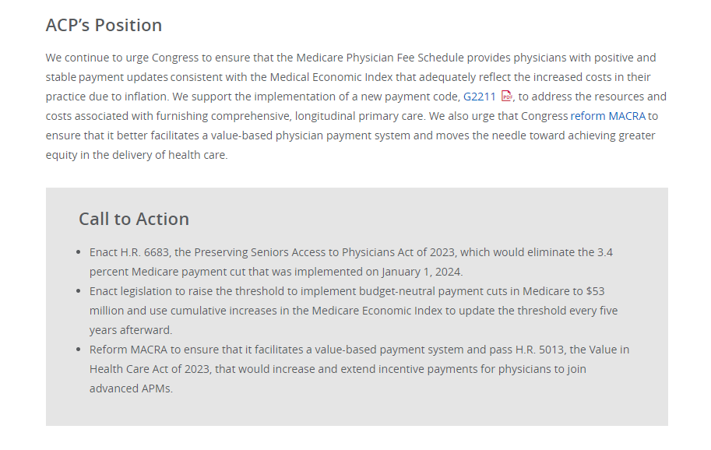

Valuing the Care Provided by IM Physicians
Inflationary updates to Medicare payment rates
Addressing budget neutrality/Medicare physician fee schedule
Policies that facilitate physicians transitioning to value-based models of care/ MACRA reform
Leadership Day 2024 Ask:
Support H.R. 6545 – the Physician Fee Schedule Update and Improvements Act

Slide 21
Physician Payment Call to Action
Support H.R. 6545 - the Physician Fee Schedule Update and Improvements Act
Raise the threshold for implementing budget neutral payment cuts from $20 million to $53 million
Would provide an increased update to the threshold every five years afterwards based on the MEI.
Update practice expense inputs, such as clinical labor costs, at least every five years
Limit the year-to-year conversion factor variance to no more than 2.5% each year
Require the Centers for Medicare and Medicaid Services (CMS) to reconcile inaccurate utilization projections based on actual claims
H.R. 6545 was passed out of the House Energy and Commerce Committee on December 6, 2023 – but it still needs to move forward in the House and also be introduced in the Senate!
Also, no CBO cost estimate is available at this time.

Slide 22
Physician Payment – ACP Policy
The American College of Physicians recommends that all payment systems substantially increase relative and absolute payments for primary care commensurate with its value in achieving better outcomes and lower costs.
Medicare payment levels to physicians for covered primary care and preventive benefits are adequate to ensure that:
beneficiaries have access to such services,
the payment rates cover physicians’ resource costs (including annual increases in the costs of providing services due to inflation), and
adequate annual updates are issued that are fair and predictable.

Slide 23
Cosponsors of H.R. 6545 - the Physician Fee Schedule Update and Improvements Act
Originally introduced by Rep. Miller-Meeks (R-IA-1)
14 cosponsors:
  Rep. Buschon* (R-IN-8)
  Rep. Schrier* (D-WA-8)
  Rep. Kelly* (D-IL-2)
  Rep. Burgess* (C-TX-26)
  Rep. Murphy* (R-NC-3)
  Rep. Bera* (D-CA-6)
  Rep. Cardenas* (D-CA-29)
  Rep. Ruiz (D-CA-25)
  Rep. Hudson (R-NC-9)
  Rep. Joyce (R-PA-13)
  Rep. Davis (D-NC-1)
  Rep. Reschenthaler (R-PA-14)
  Rep. Estes (R-KS-4)

Slide 24
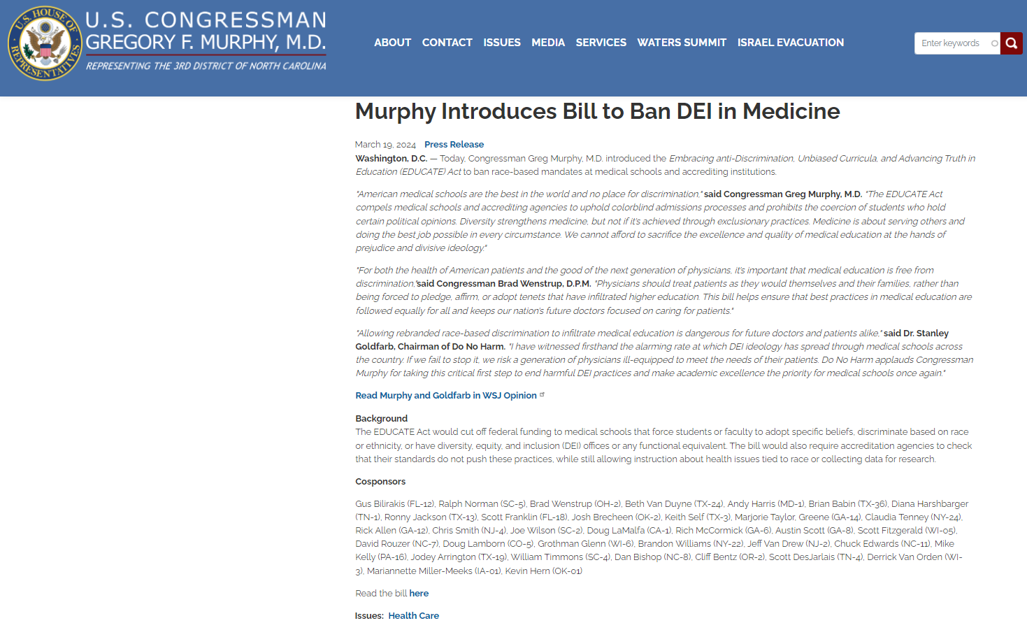
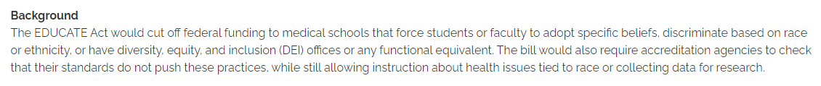
New Threat(s) to Increasing the Diversity of the Physician Workforce

Slide 25
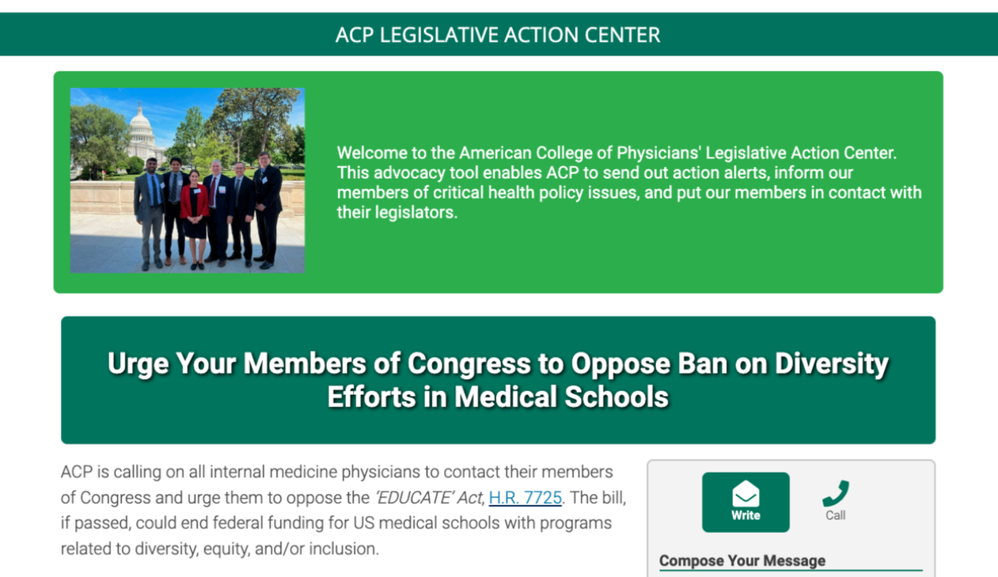
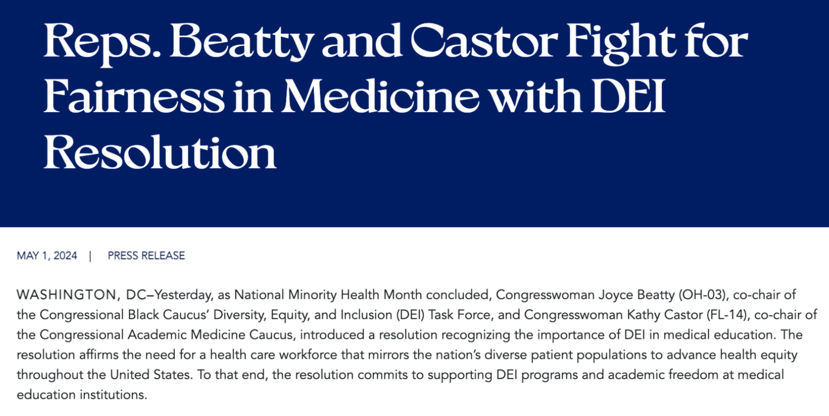
ACP has been opposing the EDUCATE Act

Slide 26
Cosponsors of H.R. 6545 (Physician Fee Schedule Update and Improvements Act) – Crossover with the House EDUCATE Act
Originally introduced by Rep. Miller-Meeks (R-IA-1)
14 cosponsors:
  Rep. Buschon* (R-IN-8)
  Rep. Schrier* (D-WA-8)
  Rep. Kelly* (D-IL-2)
  Rep. Burgess* (C-TX-26)
  Rep. Murphy* (R-NC-3) – Introduced the EDUCATE Act
  Rep. Bera* (D-CA-6)
  Rep. Cardenas* (D-CA-29)
  Rep. Ruiz (D-CA-25)
  Rep. Hudson (R-NC-9)
  Rep. Joyce (R-PA-13)
  Rep. Davis (D-NC-1)
  Rep. Reschenthaler (R-PA-14)
  Rep. Estes (R-KS-4)
Senate Version: S. 4115 – Introduced by Sen. Kennedy (R-LA)
One cosponsor – Sen. Schmitt (R-MO)

Slide 27
Physician Payment – What to say if:
I [and/or Representative(s) XX] am/is/are supportive of H.R. 6545 - the Physician Fee Schedule Update and Improvements Act AND also of the EDUCATE Act. What does ACP think about the EDUCATE Act? Can we count on your support there as well?
ACP believes that DEI programs in medical education serve to:
However, we are not here to discuss this bill today—and recognize that we may not be able to agree on all issues, but sincerely appreciate your support for H.R. 6545 and are interested in working together to help move that bill forward.
If you would like any additional information about ACP’s positions regarding the EDUCATE Act or DEI more broadly, I can have the ACP staff follow up with you.
address the current and historical underrepresentation of certain groups in the field of medicine,
improve health outcomes of underserved and marginalized communities,
promote equity and understanding among clinicians and patients, and
facilitate quality care through an inclusive physician workforce.

Slide 28
Physician Payment – What to say if:
Why should Congress intervene yet again to invest in the physician fee schedule rather than letting existing law take effect (i.e., MACRA, budget neutrality).
Also, didn’t primary care payment benefit from the recent implementation of G2211
While the implementation of G2211 was welcome and needed, it is still only a step along the way toward addressing the historic undervaluation of primary care services.
Further, this issue is indicative of broader systemic flaws in the Medicare physician fee schedule itself that must be addressed—and this bill would move us significantly in the right direction.
Most importantly, share any specific stories about your own practice’s experience and how critical having a stable payment system is to your and your patients’ well-being.

Slide 29
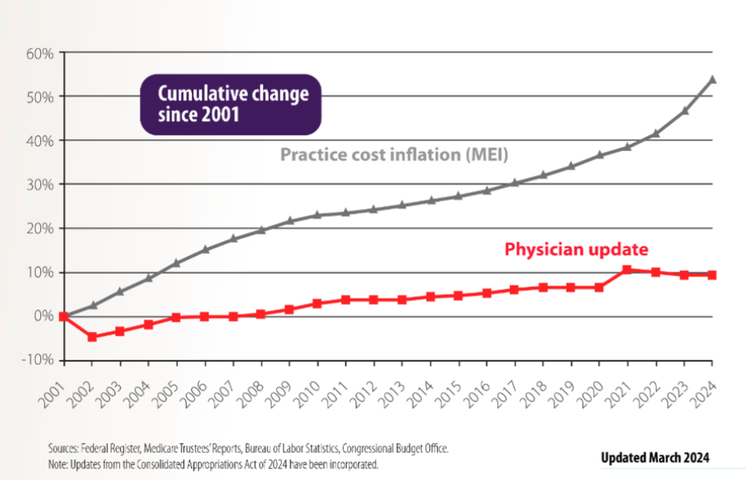
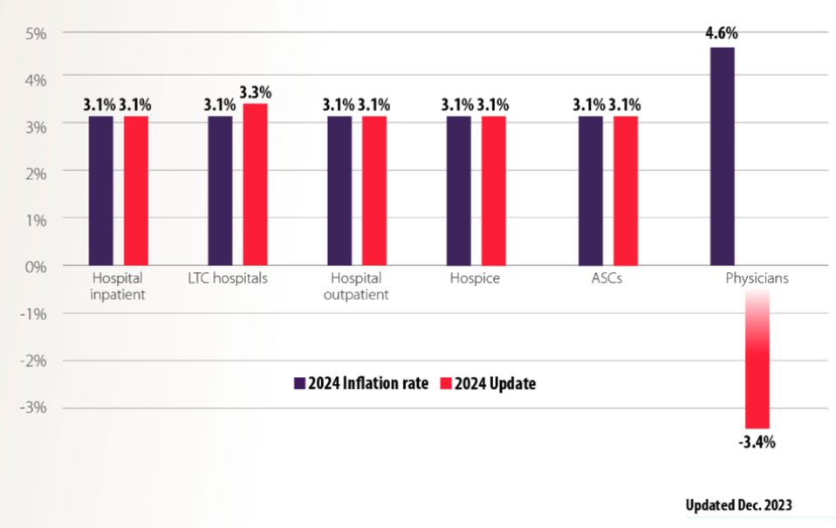
Adjusted for inflation in practice costs, Medicare physician payment declined 29% from 2001 to 2024

Slide 30
Physician Payment – What to say if:
You lawmaker expresses interest in or support for this issue but is uncertain about what bills we are supporting or what to do about it.
Provide them with the “leave behind” folder, which explains the issue and the bill(s) we are asking them to support.
Give examples from your own practice and/or your patient experiences to reflect the impact of the lack of an inflationary update on physician payment to your practice and the long-term issue primary care and internal medicine services being undervalued overall.

Slide 31

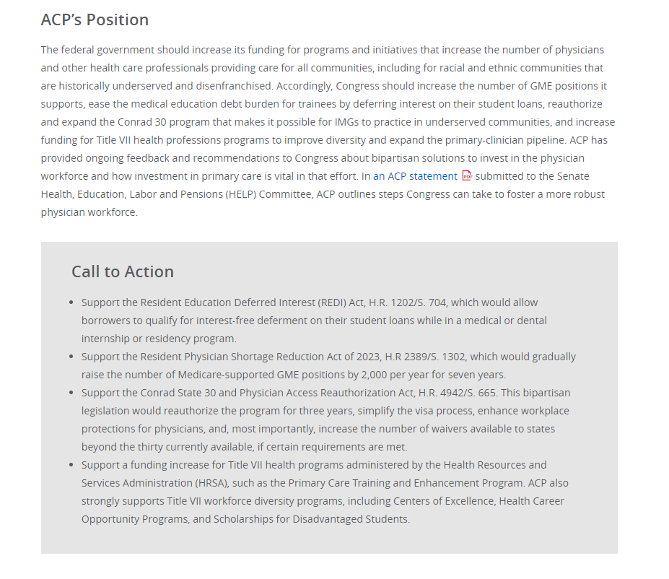
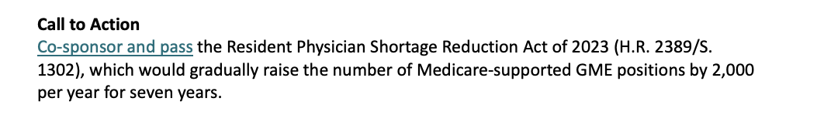
Strengthening Primary Care and the Physician Workforce
Increase GME slots to improve access to primary care/ Residency slots
Support Conrad 30 program
HRSA funding – title VII programs that support DEI and primary care
Leadership Day 2024 Ask:
Support H.R. 2389/S. 1302 – the Resident Physician Shortage Reduction Act of 2023

Slide 32
Physician Workforce Call to Action
Cosponsor and pass H.R. 2389/S. 1302, The Resident Physician Shortage Reduction Act of 2023
Gradually raises the number of Medicare-supported GME positions by 2,000 per year for seven years (so a total of 14,000 new GME positions).
It is estimated that there will be a shortage of 17,800 to 48,000 primary care physicians by 2034.
A 2021 report by the National Academy of Sciences, Engineering and Medicine called on policymakers to increase investment in primary care as evidence shows that it is critical for achieving health care’s quadruple aim.
GAO report on strategies to increase the diversity of the health professional workforce, including with respect to representation from rural, low-income, and minority communities

Slide 33
Physician Workforce
ACP Policy:
ACP strongly supports federal training programs to ensure that an adequate workforce exists to provide primary care to patients.
Graduate medical education is a unique public good that benefits all of society and must be financially supported by all who pay for health care services.
Funding should be maintained and increased for programs and initiatives that increase the number of physicians and other health care professionals providing care for all communities, including for racial and ethnic communities historically underserved and disenfranchised.
Graduate medical education provides intense educational experiences and supervised hands-on training that is required to prepare physicians for clinical practice

Slide 34

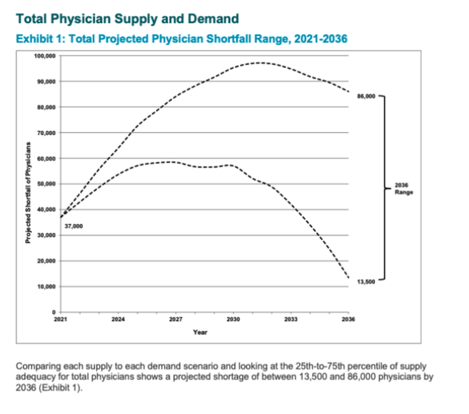
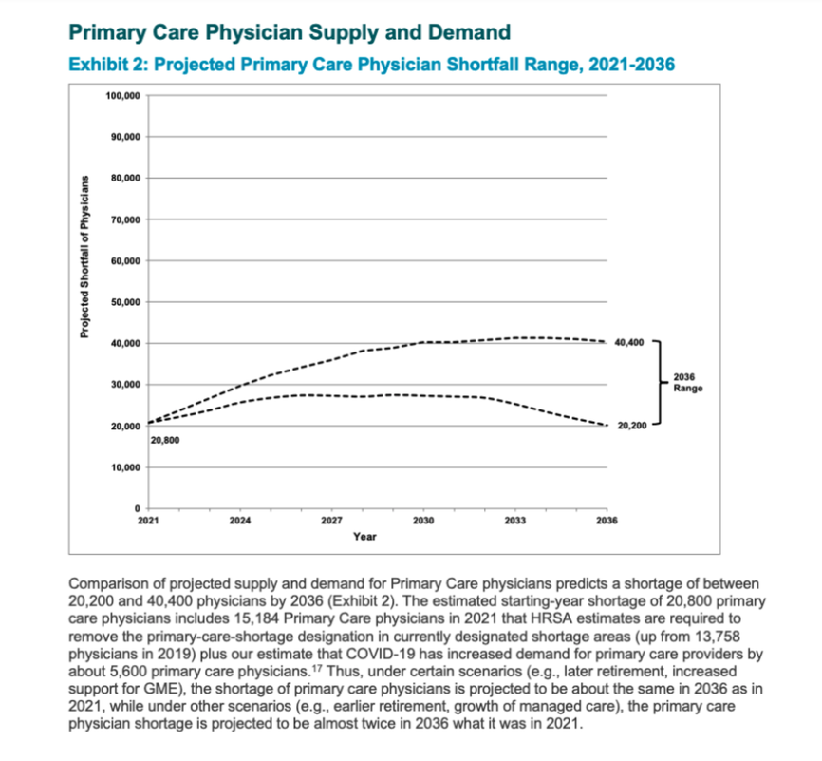
New Data on Physician Shortages – from AAMC

Slide 35
Key findings from the AAMC Report (March 21, 2024)
Demographics — specifically, population growth and aging — continue to be the primary drivers for increasing the need for more doctors to meet the health care needs of tomorrow.
A large portion of the physician workforce is nearing the traditional retirement age.
In addition, the AAMC examined and found that if communities underserved by the nation’s health care system could obtain care at the same rate as populations with better access to care, the nation would have needed approximately 202,800 more physicians as of 2021.
This is more than five times the magnitude of current shortfall estimates based on current utilization
Physicians aged 65 or older are 20% of the clinical physician workforce, and those between age 55 and 64 are 22% of the clinical physician workforce.
By 2036, the U.S. population is projected to grow by 8.4%. Additionally, the population aged 65 and older is projected to grow by 34.1%, with an increase of 54.7% in the size of the population aged 75 and older.

Slide 36
The Resident Physician Shortage Reduction Act of 2023
House of Representatives (H.R. 2389)
Senate (S. 1302)
Introduced by Rep. Sewell (D-AL-7)
175 cosponsors:
  155 Democrats
  20 Republicans
Across 40 states and territories
Introduced by Sen. Menendez (D-NJ)
7 cosponsors:
  5 Democrats
  2 Republicans
Across 7 states
Bipartisan – but note that there is no CBO cost estimate available for this bill

Slide 37
Physician Workforce – What to say if:
You lawmaker expresses interest in or support for these issues but is uncertain about what bills we are supporting or what to do about it.
You answer: Promise to provide them with an the “leave behind” folder, which explains the issue and the bill(s) we are asking them to support.
Give examples from your own practice and/or your patient experiences to reflect the importance of additional graduate medical education (GME) positions to the public good and education of the physician workforce.

Slide 38


ACP

Slide 39
Thank you!

